Slide 1
Introduction to Data Management System for IoT
SQLite Database Introduction
Vraj Suratwala
Department of ICT, VNSGU

Slide 2
Introduction
SQLite is a lightweight, open-source, serverless, self-contained, and relational database management system (RDBMS). It stores the complete database in a single file on the device and does not require a separate database server.
SQLite is widely used in IoT devices, embedded systems, mobile applications, desktop applications, and small-scale applications where a simple and low-resource database is required.

Slide 3
Features of SQLite
Serverless
  SQLite does not require a separate database server such as MySQL or PostgreSQL.
  The application directly reads and writes the database file.
Lightweight
  SQLite has a very small footprint and requires fewer system resources such as RAM, CPU, and storage. Therefore, it is suitable for resource-constrained IoT devices.
Self-Contained
  SQLite contains all the necessary database functionality within the SQLite library itself. It does not depend on external database software.
Single Database File
  The entire database—including tables, indexes, and data—is generally stored in a single file.
  For example:iot_database.db
  This makes database management, backup, and transfer easy.

Slide 4
Features of SQLite
Zero Configuration
  SQLite does not require complicated installation, configuration, or administration of a database server.
Supports SQL
  SQLite supports SQL (Structured Query Language) for creating, inserting, updating, deleting, and retrieving data.
  Example:
  CREATE TABLE Sensor (
  id INTEGER,
  temperature REAL
  );

Slide 5
Features of SQLite
Cross-Platform
  SQLite can be used on different operating systems and platforms such as:
  Windows
  Linux
  macOS
  Android
  Embedded systems

Slide 6
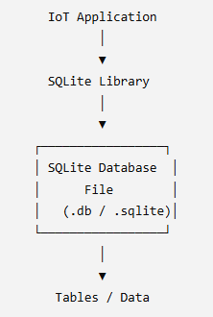
SQLite Architecture
SQLite follows a simple architecture where the application directly interacts with the SQLite database.
Unlike traditional database systems, there is no separate database server between the application and the database.

Slide 7
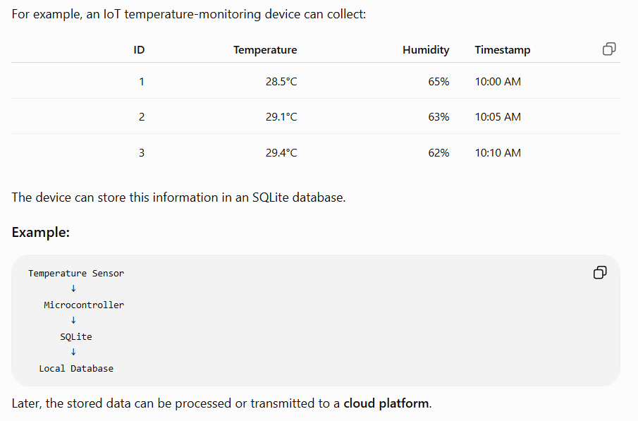
SQLite in IoT
SQLite is particularly useful in IoT systems for storing sensor data locally.

Slide 8
Advantages of SQLite
Simple to use
No database server required
Low memory and storage requirement
Easy to install and configure
Supports SQL
Portable because the database is stored in a file
Suitable for embedded and IoT applications
Provides transactions and data integrity
Open-source and free to use

Slide 9
Limitations of SQLite
Although SQLite is useful for IoT and small applications, it has some limitations:
It is not designed for large-scale client-server applications.
Concurrent writing is limited compared with server-based databases.
It does not provide the full range of features available in enterprise databases.
It is less suitable for applications requiring many simultaneous users and heavy database operations.
Database access is primarily local rather than through a dedicated database server.

Slide 10
Applications of SQLite
IoT and embedded systems
Mobile applications
Desktop applications
Web browsers
Local data storage
Sensor-data logging
Small-scale applications
Offline applications
Testing and prototyping

Slide 11
Practical Aspect
Basic SQLite Commands
  Create/Open a Database :
    sqlite3 iot.db
  Create a Table
    CREATE TABLE Sensor (
    id INTEGER PRIMARY KEY,
    temperature REAL,
    humidity REAL
    );
  View Tables
    .tables

Slide 12
Practical Aspect
View Table Structure
  .schema Sensor
Insert Data
  INSERT INTO Sensor (temperature, humidity) VALUES (28.5, 65);
Display Data
  SELECT * FROM Sensor;
Exit SQLite
  .quit or .exit

Slide 13
Practical Aspect - Create/Insert
INSERT INTO Sensor (temperature, humidity) VALUES (30.2, 60);
  OR
INSERT INTO Sensor (temperature, humidity)
VALUES
(28.5, 65),
(29.1, 63),
(30.2, 60);

Slide 14
Practical Aspect - Retrieve Data
Display all records:
  SELECT * FROM Sensor;
Display specific columns:
  SELECT temperature, humidity FROM Sensor;
Retrieve a specific record:
  SELECT * FROM Sensor WHERE id = 2;
Retrieve temperature above 30°C:
  SELECT * FROM Sensor WHERE temperature > 30;

Slide 15
Practical Aspect - Remove Data
Conditional Delete
  DELETE FROM Sensor WHERE id = 2;
To delete all records:
  DELETE FROM Sensor;

Slide 16
Practical Aspect - Modify Data
The UPDATE command modifies existing records.
  UPDATE Sensor
  SET temperature = 31.5
  WHERE id = 2;
This changes the temperature of the record whose ID is 2.
Important: Always use a WHERE condition when updating specific records. Otherwise, all records may be modified.

Slide 17
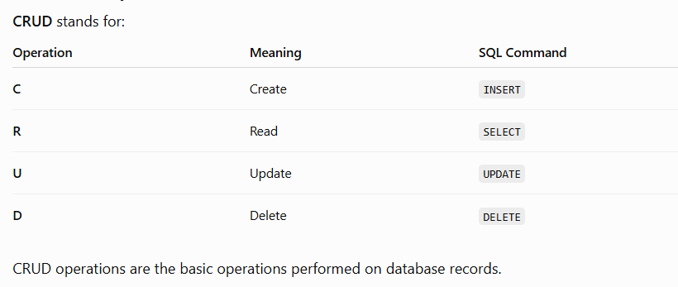
CRUD Operation in SQLite

Slide 18
Thank you
Vraj Suratwala
Department of ICT, VNSGU

